Slide 1
The cell biology lab 2
Preparation of temporary slides

Slide 2
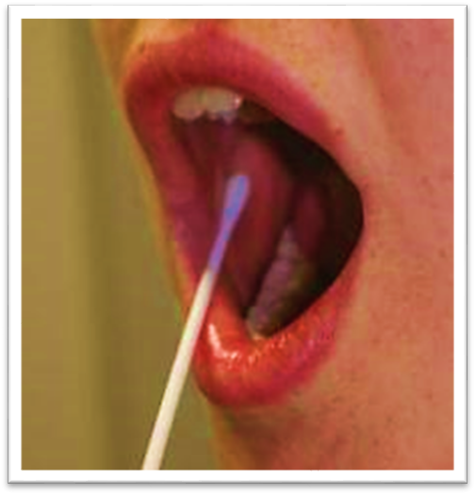
1- Animal epithelial cell: (Swab from lining of the mouth)

Slide 3
method:
1- Take a clean cotton swab and gently scrape the inside of your mouth.
2- Smear the cotton swab on the center of the microscope slide for 2 to 3 seconds.
3- Add a drop of methylene blue solution and place a cover slip on top.
4- Remove any excess solution by allowing a paper towel to touch one side of the cover.
5- Place the slide on the microscope, with 4 x or 10 x objective in position and find a cell. Then view at higher magnification

Slide 4
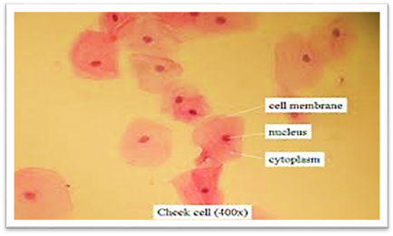

Slide 5
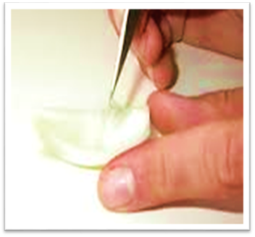
2- Plant cells (Allium cepa): (Small piece from the underside of onion)

Slide 6
:method
1- First add a few drops of water on the slide to avoid dryness and
2- Take a small piece of onion and using forceps (tweezers), peel off the membrane from the underside (the rough side).
3- Lay the membrane flat on the surface of the slide.
4- Add a drop of Neutral red solution.
5- Using a pin, lower the thin glass cover slip or cover glass onto the slide. Make sure there are no air bubbles.
6- Place the slide on the microscope, with 4 x or 10 x objective in position and find a cell. Then view at higher magnification.

Slide 7
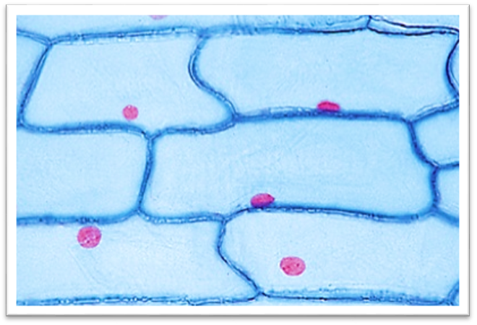
Allium cepa cells

Slide 8
Some vital stains and their uses
Natural Red→ Cytoplasm
Methylene Blue → Golgi apparatus
Jonus Green B → Mitochondria

Slide 9
Comparison between Animal cell and Plant cell

Slide 10
Characteristics | Animal cell | Plant cell
Cell size | Small | Large
Cell wall | Absent | Present surrounds the plasma membrane
Vacuole | If found it is small | Present and Large
Plastids | Absent | Present
Division direction | Outside to inside | Inside to outside
Centrioles | Present | Absent

